Slide 1


Holographic Microscope Optimal Configuration
Tom Zimmerman
IBM Research-Almaden
Feb 18, 2021
This material is based upon work supported by the NSF under Grant No. DBI-1548297.
Disclaimer: Any opinions, findings and conclusions or recommendations expressed in this material are those of the authors and do not necessarily reflect the views of the National Science Foundation.

Slide 2
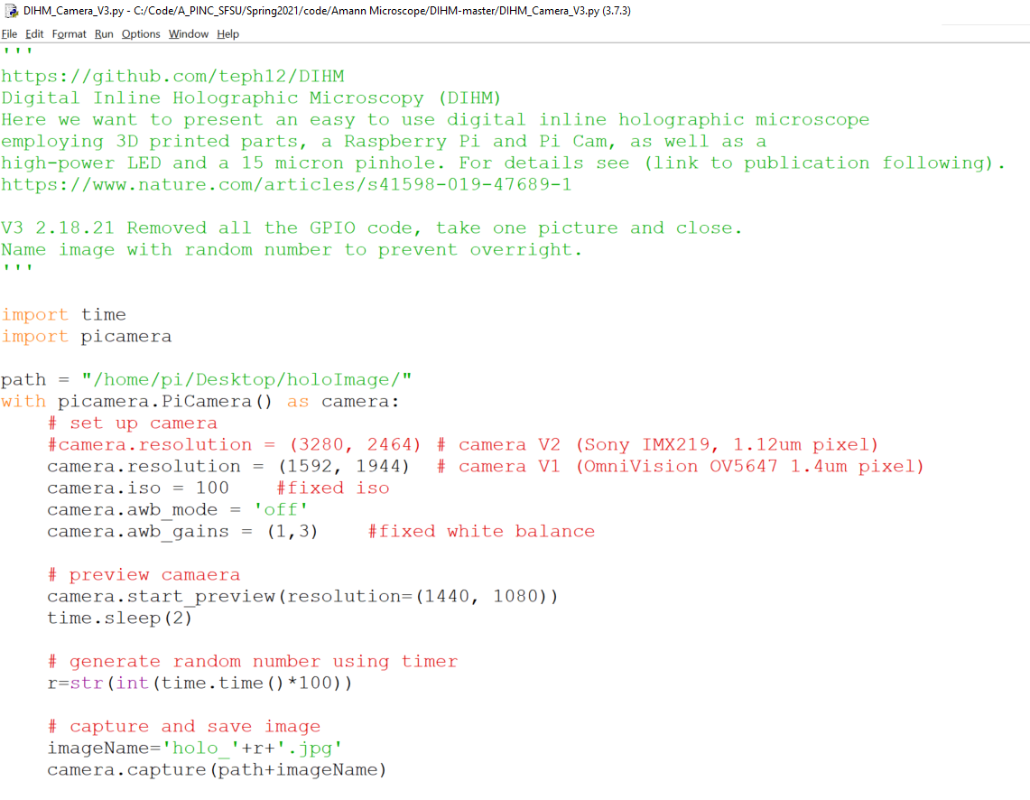
DIHM_Camera_V3.py

Slide 3
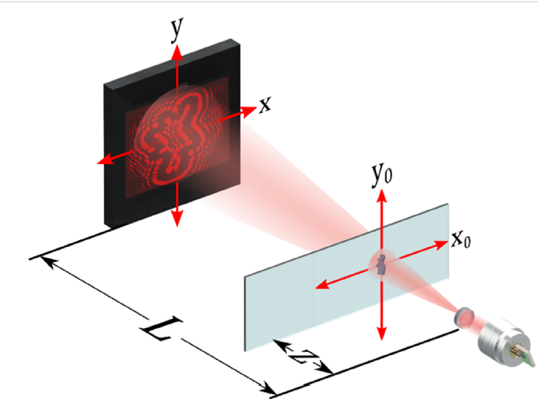
Magnification
M=L/z
Open-source, cost-effective, portable, 3D-printed digital lensless holographic microscope
Heberley Tobon-Maya, Samuel Zapata-Valencia, Erick Zora-Guzman, Carlos Buitrago-Duque, AND Jorge Garcia-Sucerquia*
School of Physics, Universidad Nacional de Colombia—Sede Medellin, A.A: 3840, Medellin 050034, Colombia

Slide 4
Two Operating Regimes
Gabor’s like implementation. Sample close to point source. The sample’s diffraction pattern is magnified (geometric projection) 5X to 20X (similar to optical microscope), ∼0.4–0.5NA
Lensless Holographic Microscopy (LHM) Sample close to image sensor. No geometric magnification. Resolution limit by detector, not diffraction. FOV becomes whole detector. ∼0.2 NA range. Super-resolution can be used to decrease effective pixel size.
Common Problems
Coherent Noise; use partially coherent sources, overlapping several in-line holographic images
Weak Diffraction Assumption; prevents image formation in Gabor, restricts range of samples in LHM; applying special implementations of phase-shifting holography
Twin image problem: direct consequence of the in-line configuration. Avoided in LHM by using two different strategies: phase-shifting and phase retrieval algorithms. Phase shifting: relative phase variation between interferometric beams. Phase retrieval: iterative or deterministic algorithms. Record several images in time at multi-height with glass cover slips of different thicknesses, move camera, tune the light wavelength or defocus the image.

Slide 5
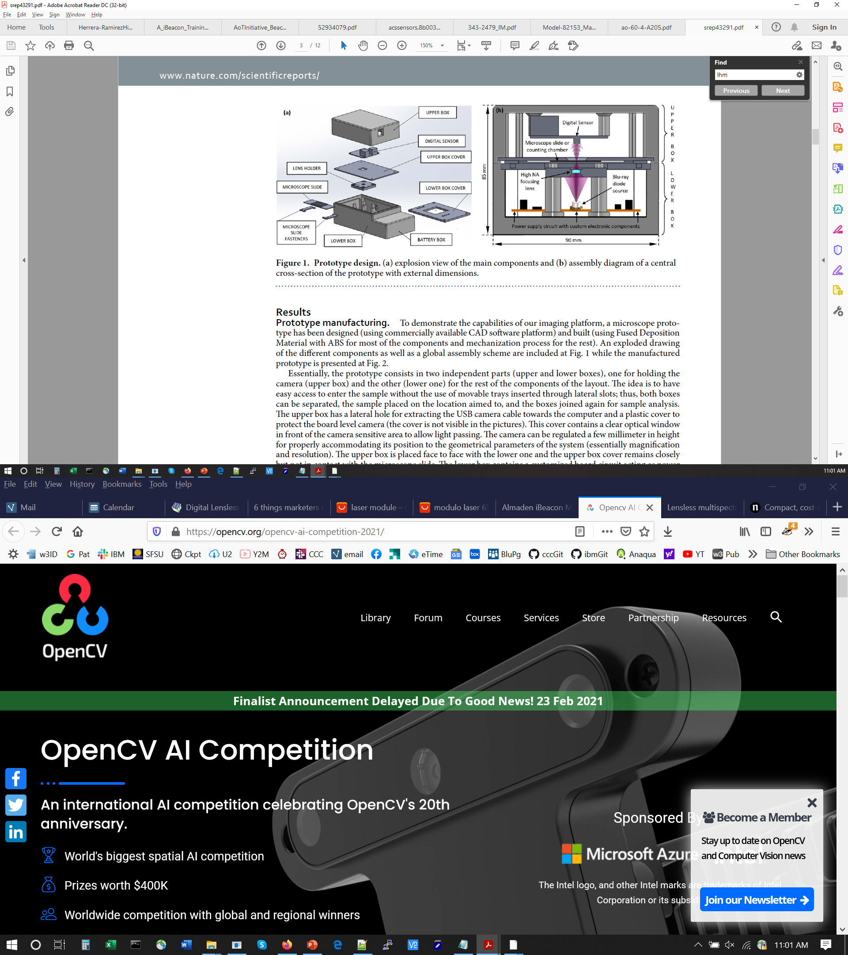
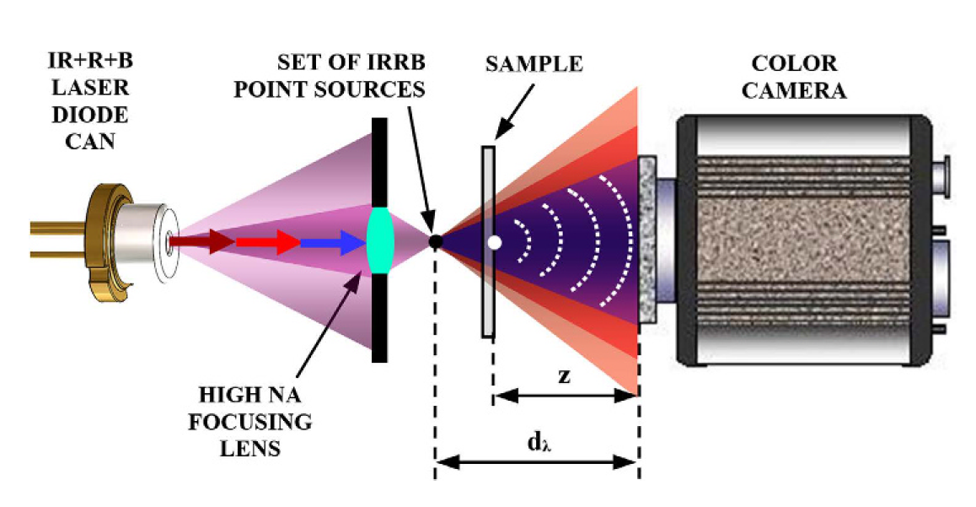
MISHELF (initials coming from Multi-Illumination Single-Holographic-Exposure Lensless Fresnel)
7 mm
0.5 mm
22 mm
commercial-grade plastic lens of 0.6NA.
Tri Color Laser: CD (IR-780nm), DVD (red-660nm) Blue-ray (blue-405nm)

Slide 6
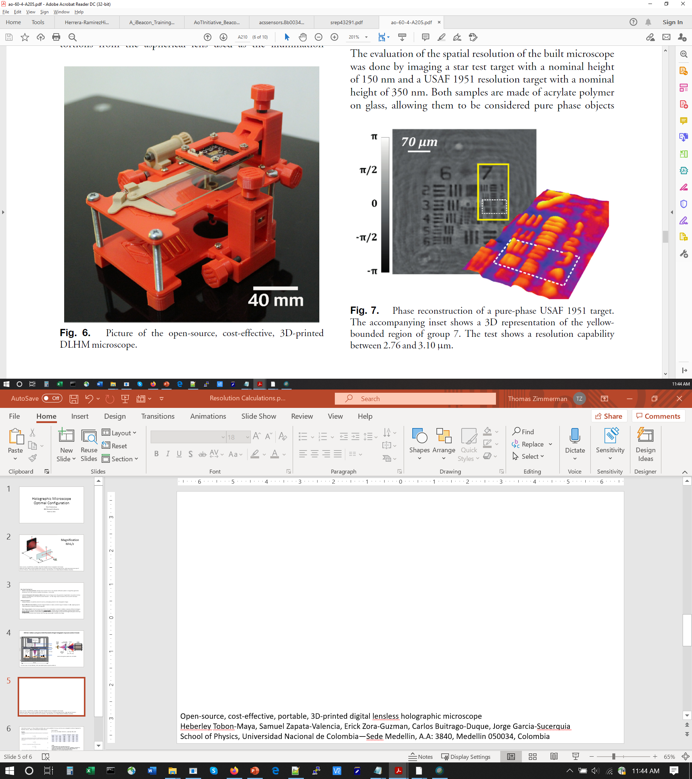
FOV 0.023 to 10mm spatial resolution 1.15 to 6.3um
Open-source, cost-effective, portable, 3D-printed digital lensless holographic microscope
Heberley Tobon-Maya, Samuel Zapata-Valencia, Erick Zora-Guzman, Carlos Buitrago-Duque, Jorge Garcia-Sucerquia
School of Physics, Universidad Nacional de Colombia—Sede Medellin, A.A: 3840, Medellin 050034, Colombia

Slide 7
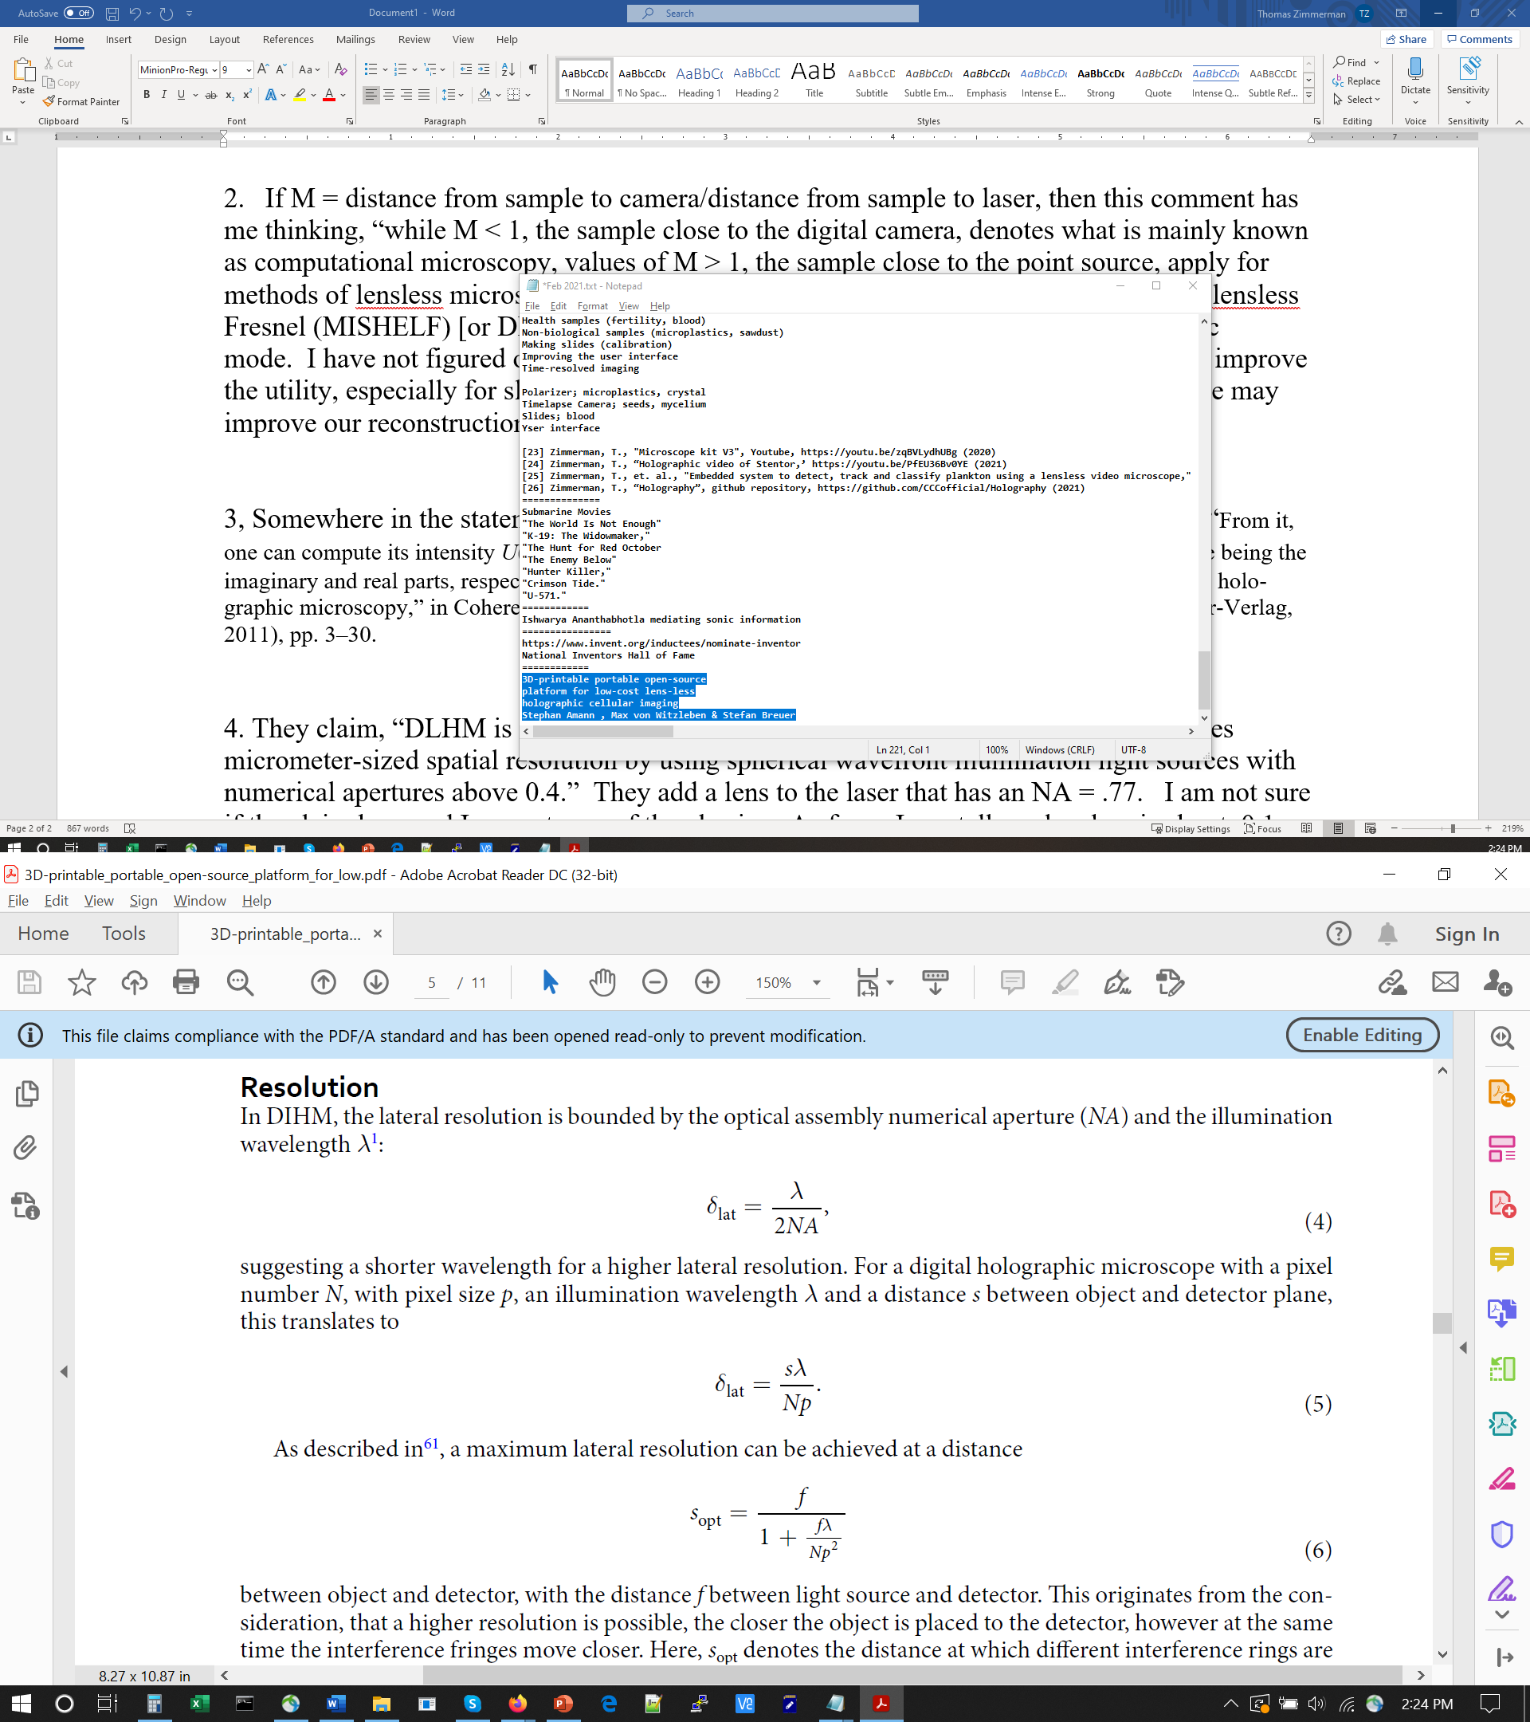
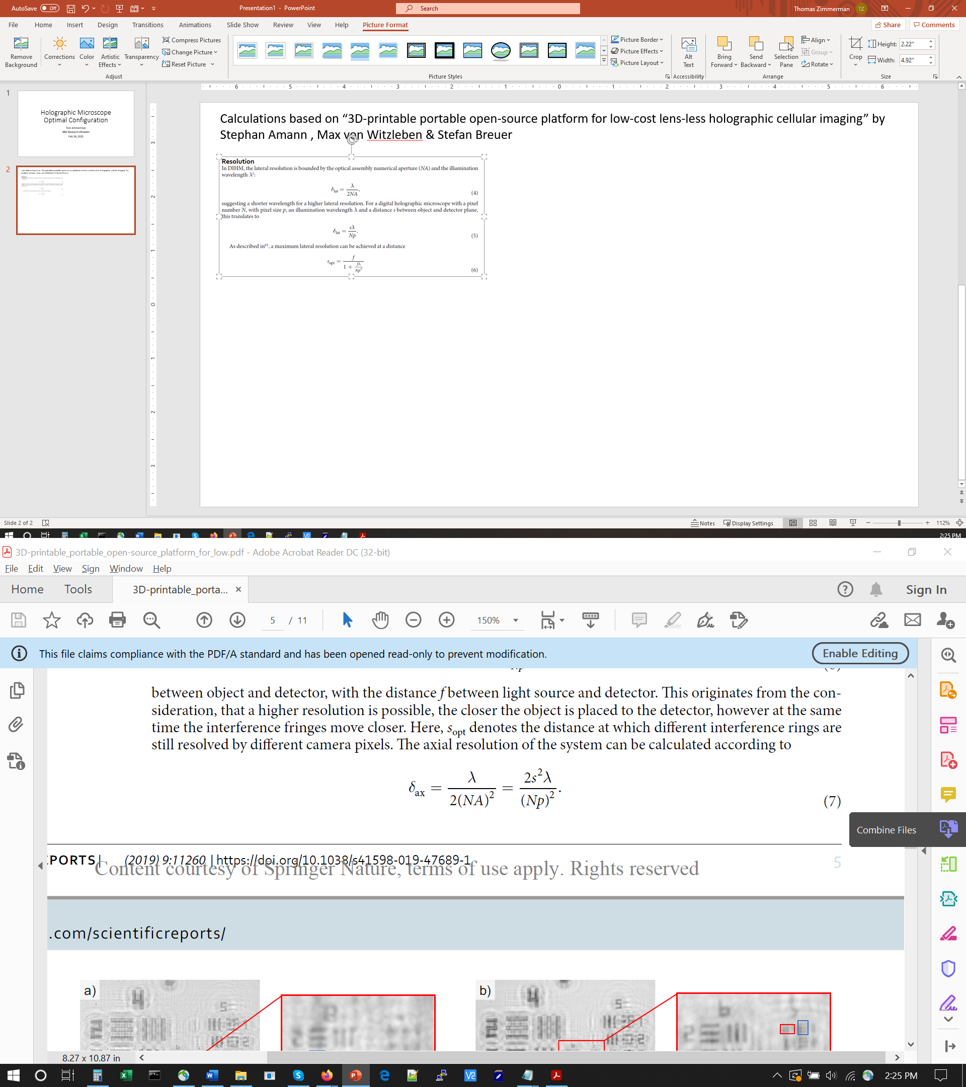
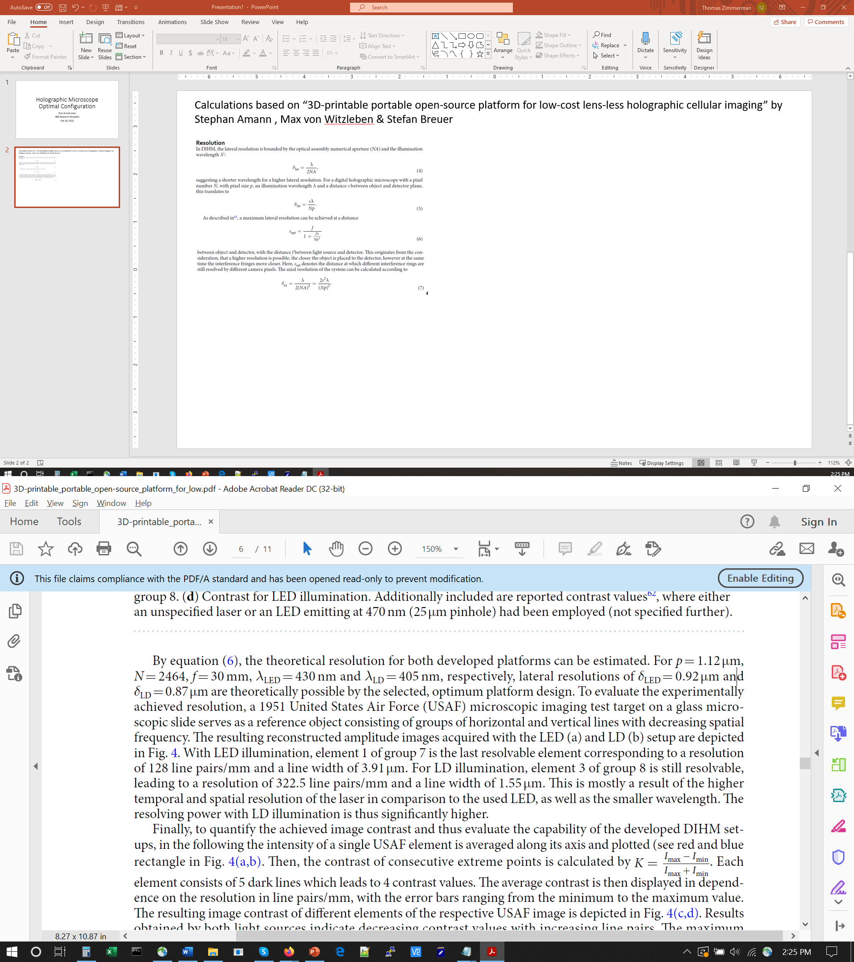
Calculations based on “3D-printable portable open-source platform for low-cost lens-less holographic cellular imaging” by
Stephan Amann , Max von Witzleben & Stefan Breuer
Their system:
p=1.12 um, N=2464, f=30 mm, L (lamda)=405, 430
SYSTEM | pix rez | N pix | Light:Detect (um) | Wavelength (um) | Obj:Det (um) | LatRez (um)
LASER | 1.12 | 2464 | 30000 | 0.405 | 6084 | 0.89
SFSU | 1.12 | 2464 | 30000 | 0.405 | 6084 | 0.89
LED | 1.12 | 2464 | 30000 | 0.43 | 5799 | 0.90
SFSU | 1.12 | 1944 | 30000 | 0.65 | 3335 | 1.00
SFSU | 1.4 | 1944 | 30000 | 0.405 | 7162 | 1.07
SFSU | 1.4 | 1944 | 30000 | 0.65 | 4904 | 1.17
LASER
SF-AW210 405um laser collimated and focused
2 aspheric lenses focal length 11mm ($87 each, C220TMD-A, Thorlabs Inc.)
Aingle-mode optical fibre, core dia 3 μm ($99, S405-XP, Nufern Inc.)
Glass plate, at z = 5.91 mm, beam diameter of 3.8 mm
LED
3 W High Power LED 430 nm–435 nm ($3)
Pinhole 15 μm ($75, P15D, Thorlabs Inc.)
The pictures are acquired with a fixed white balance.

Slide 8
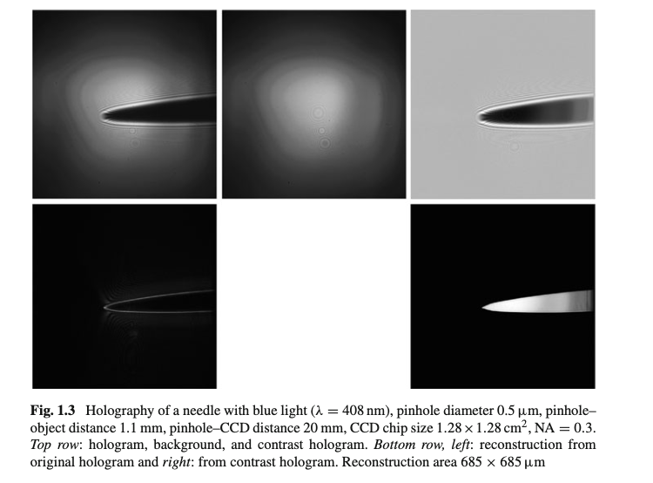

Slide 9
Holograms at times t1, t2, t3… h1, h2, h3 …
Sum as (h1-h2) + (h3-h4)+…..
Do reconstruction on one summed image
(may need to scale so not to saturate pixels)

Slide 10
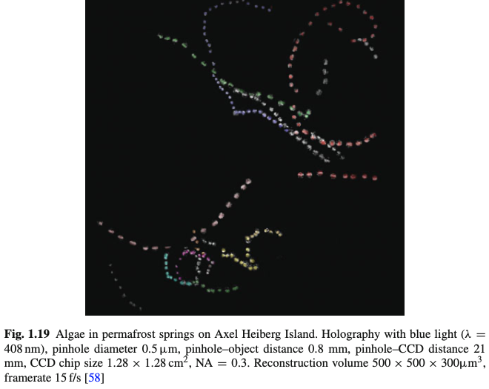
Encoding x,y,z,t in one Hologram
Capture sequence of holograms (h1, h2, h3) at times t1, t2, t3
Sum as (h1-h2) + (h3-h4)+ …..
Do reconstruction on one summed image
(may need to scale so not to saturate pixels)

